Slide 1

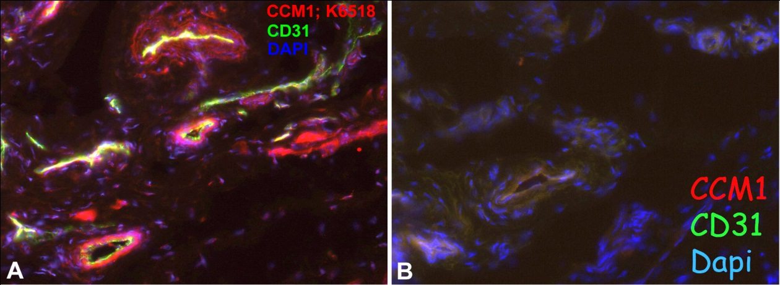
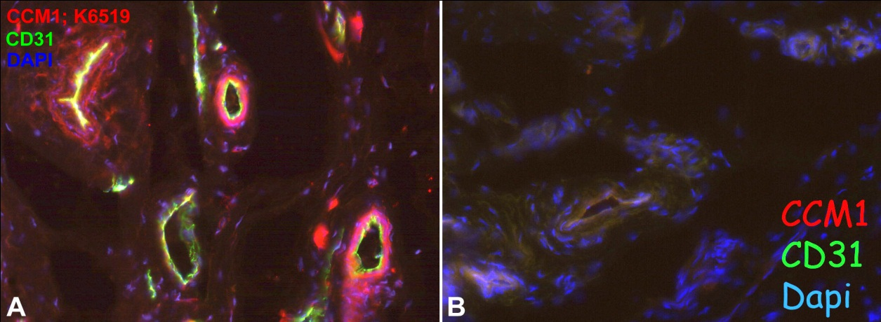
ReliaTech GmbH
Rabbit anti-human CCM1
„Cerebral cavernous malformations 1 protein “
(Cat #102-PA25S/-PA25)
Immunofluorescence staining of human foreskin (cryo-section of unfixed tissue) with anti-CCM1 (red; dilution 1:50) [Cat# 102-PA25]. Costaining of endothelial cells with anti-CD31 (green). Note specific staining in the wall of a subset of vessel. Nuclei counter-stained with Dapi (blue). Specimen provided by Prof. Dr. J. Wilting and Dr. K. Buttler, Goettingen.
The experiment was performed by the research group of Prof. Dr. J. Wilting, University Göttingen, Germany.
http://www.reliatech.de / orders@reliatech.de

